Slide 1
Acquisition of Chess Knowledge in AlphaZero^{[1]}
MI2 DataLab Summer Research Seminar 2023
^{[1]}Thomas McGrath, Andrei Kapishnikov, Nenad Tomasev, Adam Pearce, Demis Hassabis, Been Kim, Ulrich Paquet, and Vladimir Kramnik, Acquisition of Chess Knowledge in AlphaZero, Proceedings of the National Academy of Sciences
Notes:
Thomas McGrath - research scientist at DeepMind, “particularly interested in what we can learn from very capable agents, how they learn, and whether they represent their domain in ways we understand. I’m also interested in applications of interpretability to science and safety.”
Andrei Kapishnikov - Software engineer at Google Research. Invented, developed and published new ML explainability methods - XRAI and Guided IG. As the leading author, presented the methods at the ICCV and CVPR top ML conferences. The method was integrated into the Google Cloud eXplainable AI offering. In 2021, a paper that uses the method as the primary explainability tool was published in Nature. Patent pending.
Been Kim - Staff Research Scientist at Google Brain. Interested in helping humans to communicate with complex machine learning models: not only by building tools (and tools to criticize them), but also studying their nature, compared to humans. She believes the language that humans and machines communicate must be human-centered--higher-level, human-friendly concepts--so that it can make sense to everyon , regardless of how much they know about ML. One of her works - TCAV - received UNESCO Netexplo award, was featured at Google I/O 19' and in Brian Christian's book on The Alignment Problem.
Vladimir Kramnik - a russian chess grandmaster, classical world chess champion from 2000 to 2006, and the undisputed world chess champion from 2006 to 2007. He has won three team gold medals and three individual medals at Chess Olympiads.

Slide 2
Outline
What is chess?
How does AlphaZero work?
Why bother explaining it?
Encoding of human conceptual knowledge
Progression through AlphaZero and human history
Rapid increase of basic knowledge
Vladimir Kramnik’s qualitative assessment
Exploring activations with unsupervised methods

Slide 3
What is chess?

Slide 4
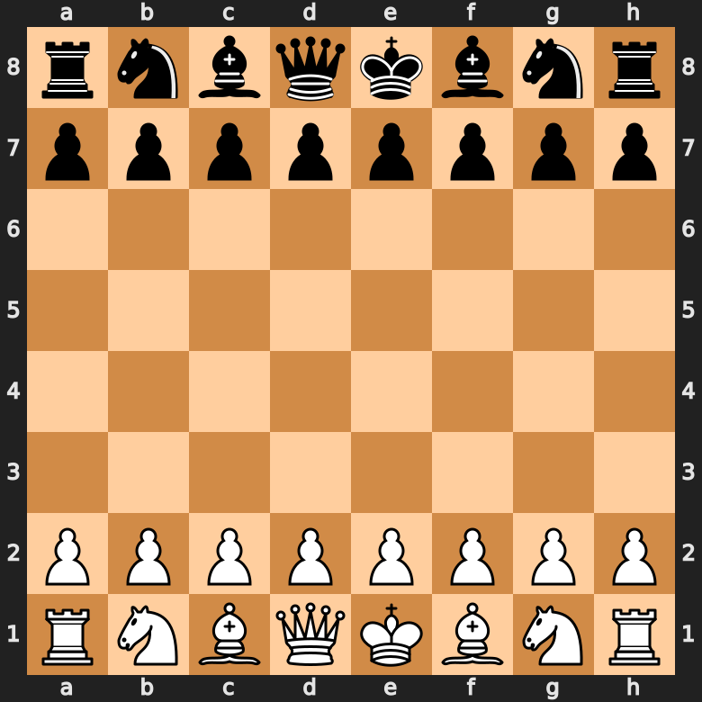
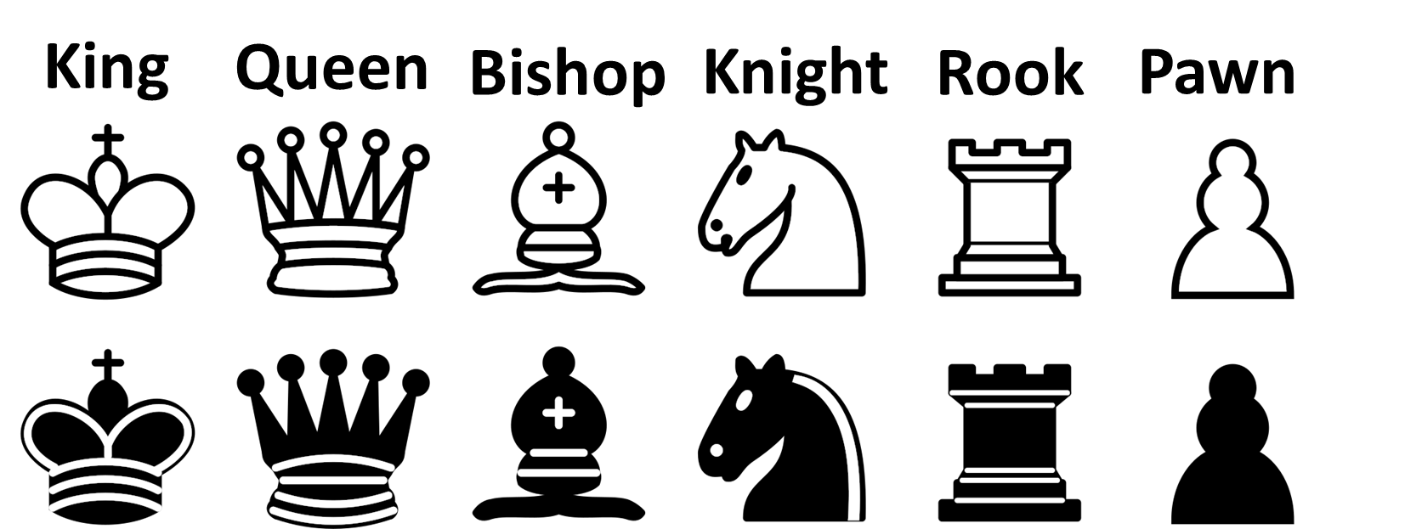
What is chess?
Notes:
Chess is a board game between two players
It’s an abstract strategy game and involves no hidden information, which makes it particularly suitable for reinforcement learning methods.
It is played on a chessboard with 64 squares arranged in an eight-by-eight grid. At the start, each player controls sixteen pieces: one king, one queen, two rooks, two bishops, two knights, and eight pawns. The player controlling the white pieces moves first, followed by the player controlling the black pieces.
A game of chess ends when a player puts the opposing player's king in a position that cannot avoid capture (checkmate).

Slide 5
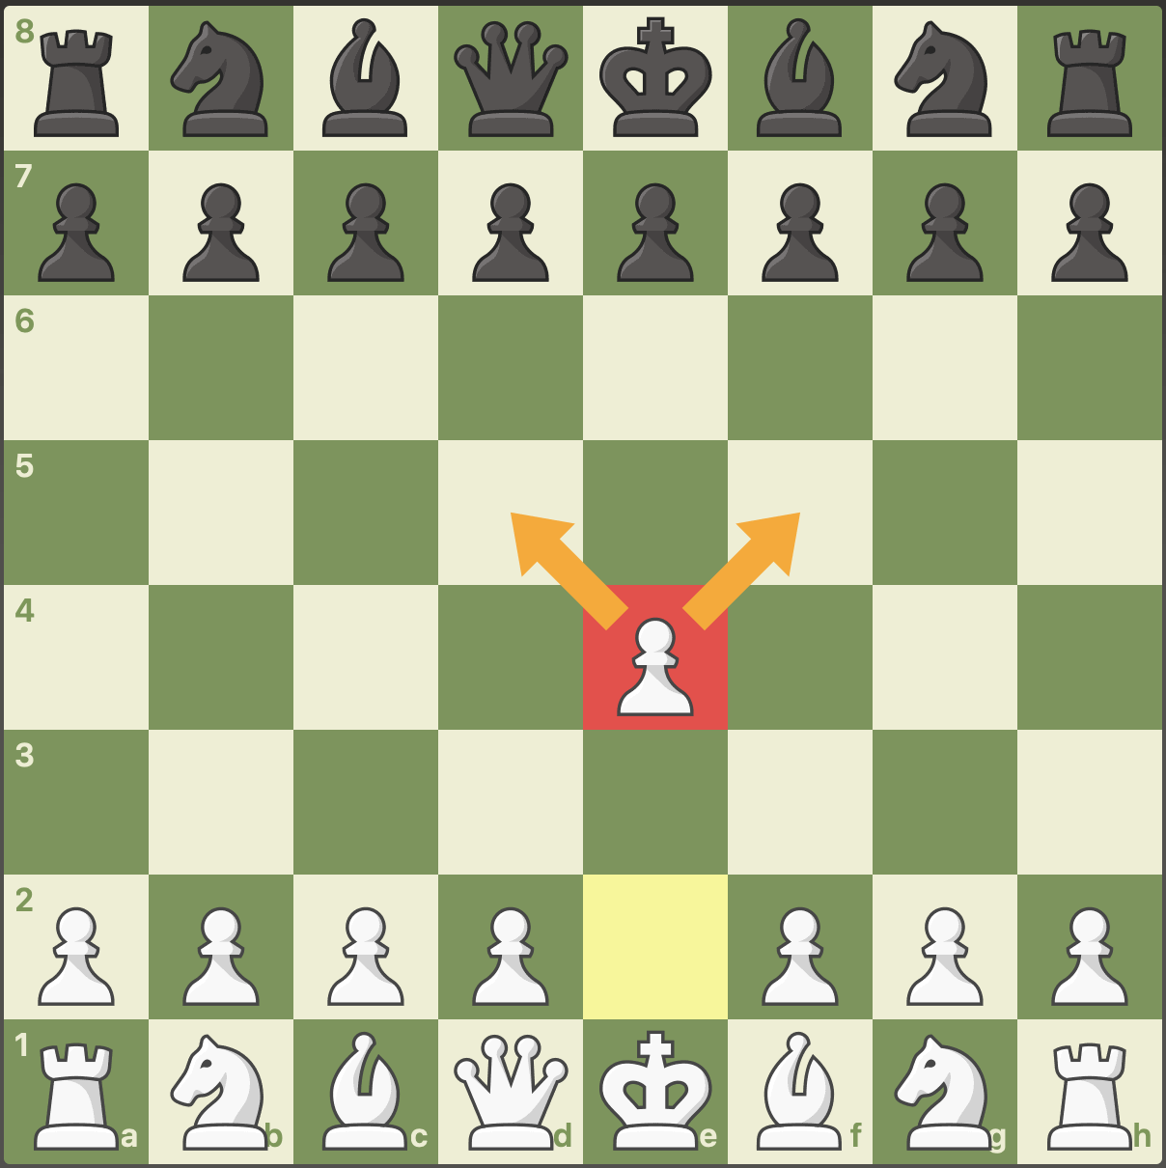
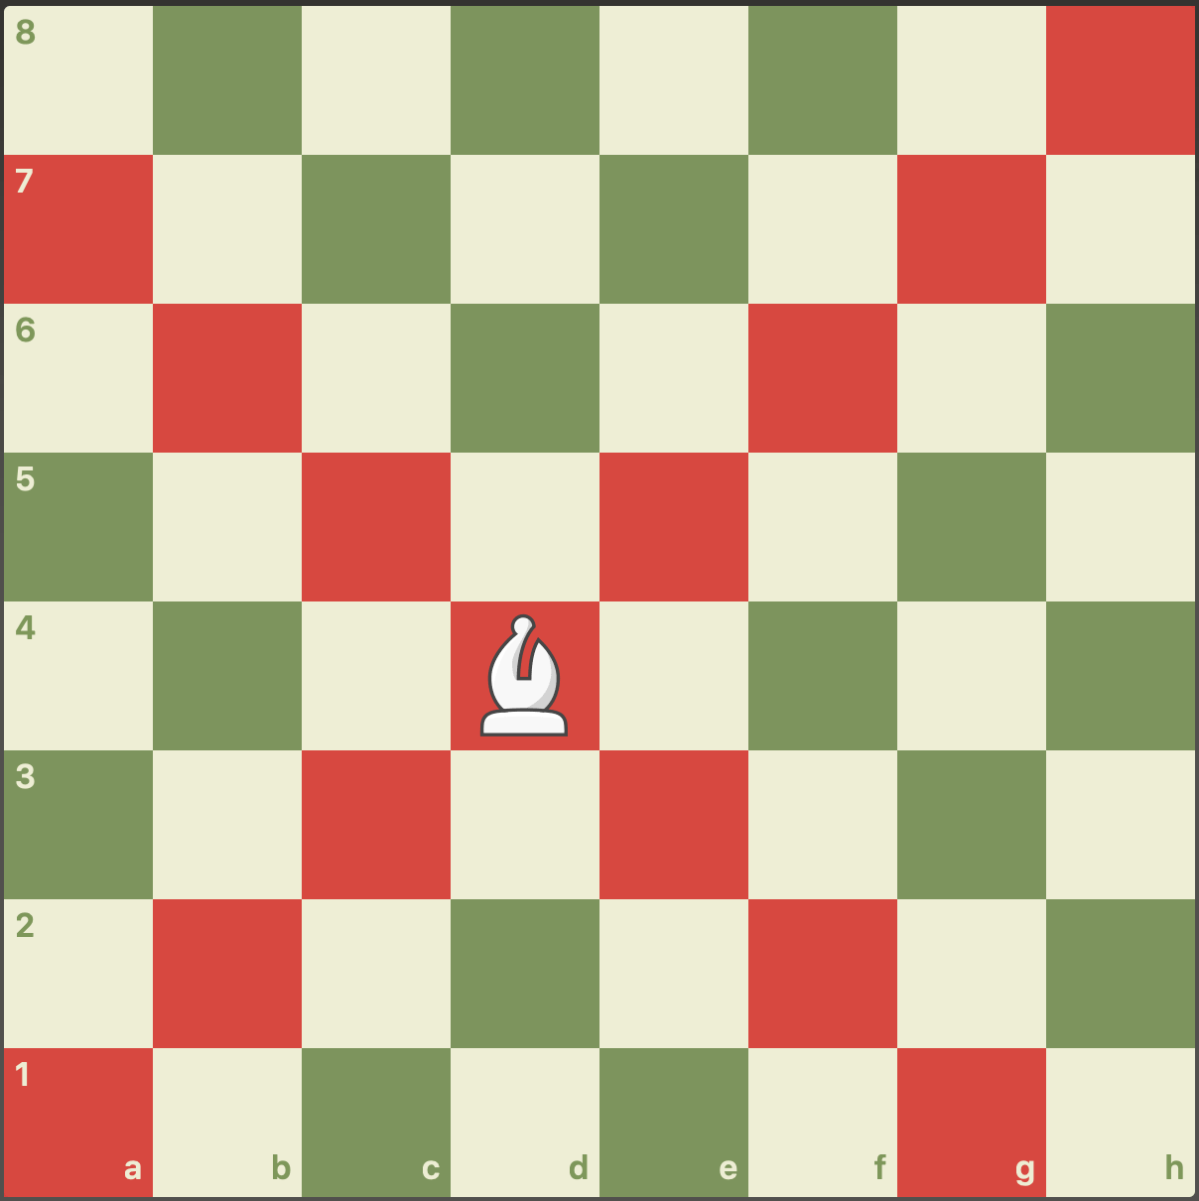
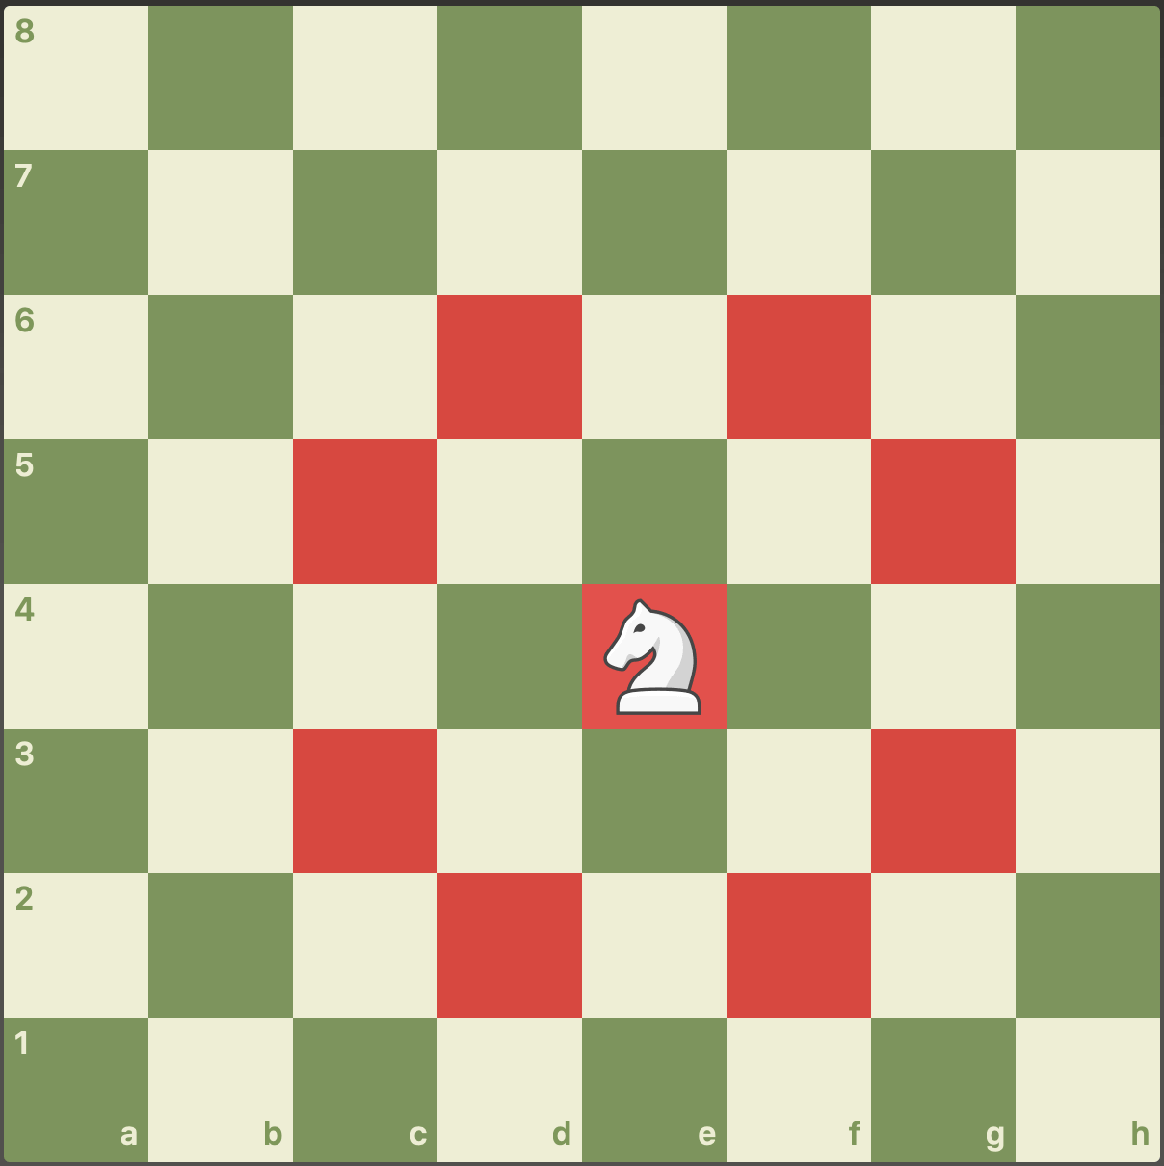
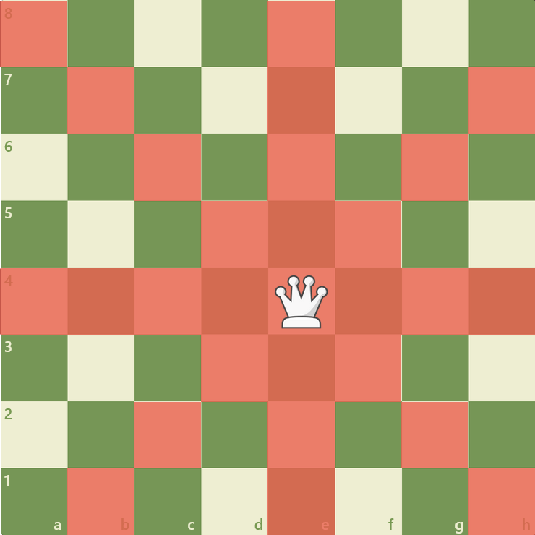
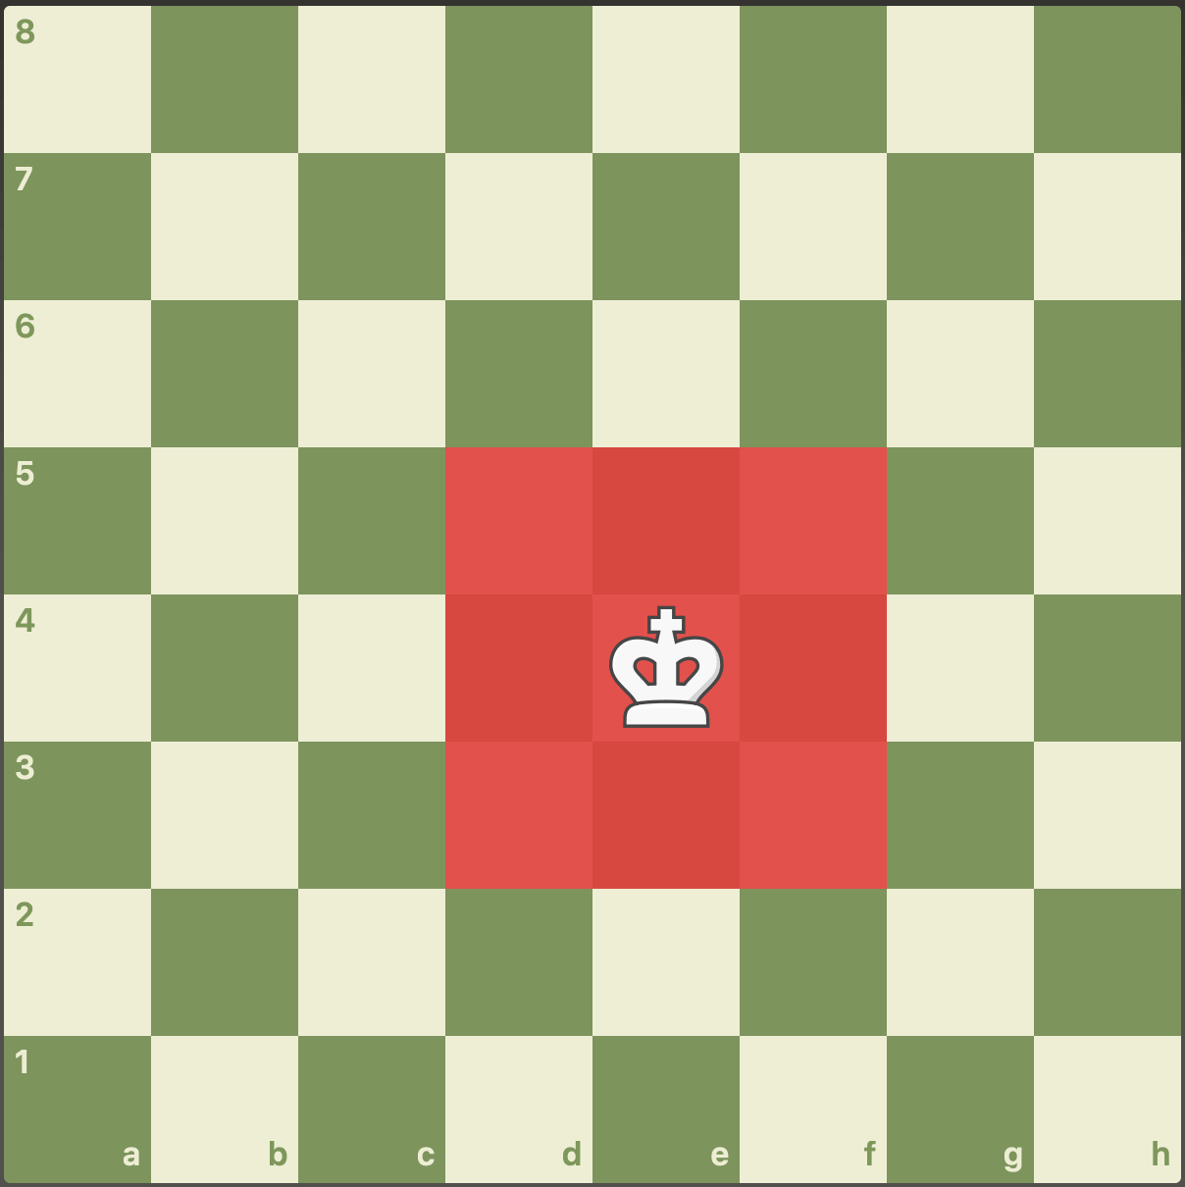
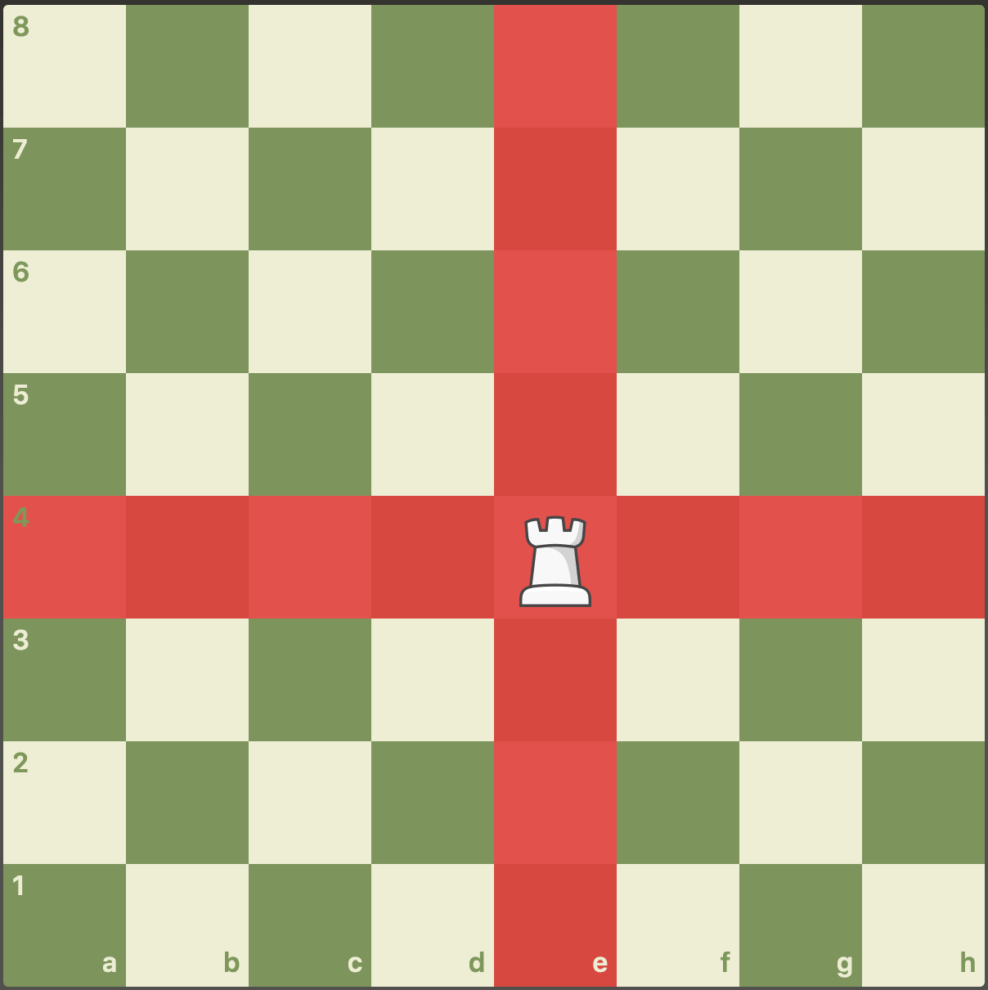
What is chess?
Pawn
Bishop
Knight
Queen
King
Rook
Notes:
White moves first, after which players alternate turns, moving one piece per turn, except for castling when two pieces are moved.
A piece is moved to either an unoccupied square or one occupied by an opponent's piece, which is captured and removed from play. With the sole exception of en passant, all pieces capture by moving to the square that the opponent's piece occupies.
Moving is compulsory; a player may not skip a turn, even when having to move is detrimental.

Slide 6
How does AlphaZero work?
Notes:
AlphaZero learns fully from self-play, no human data is used.

Slide 7
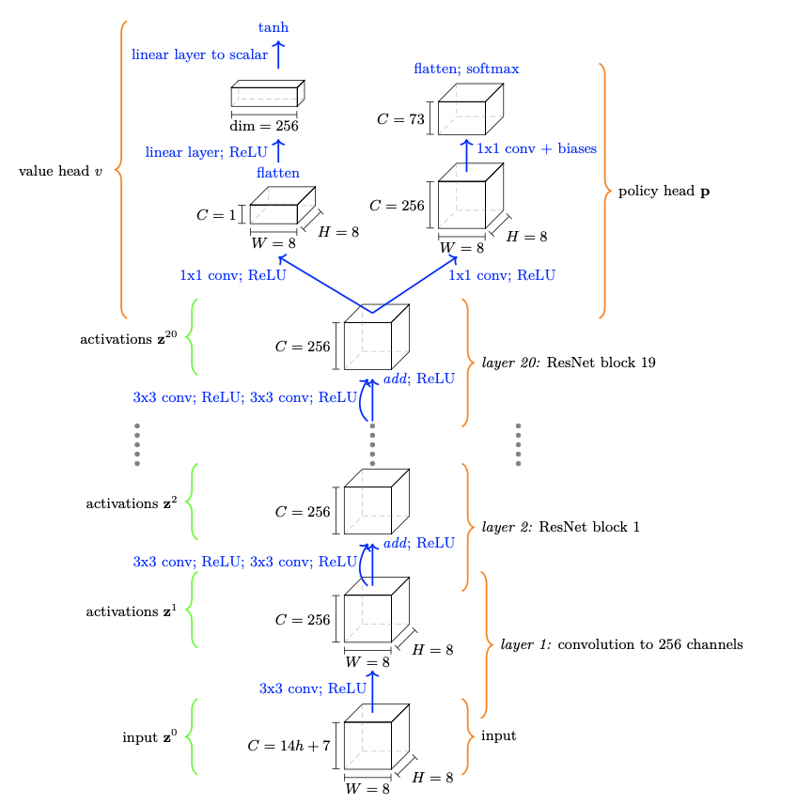
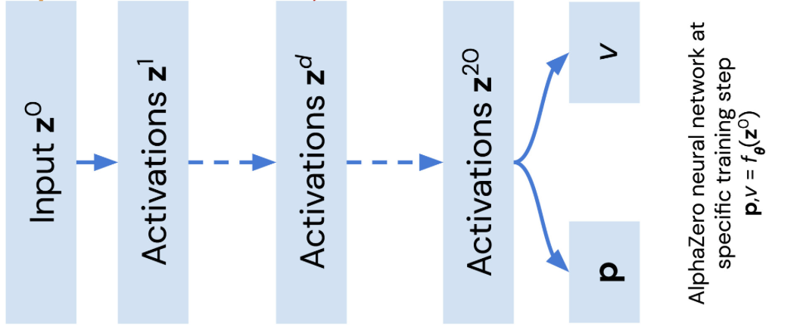
How does AlphaZero work?
Notes:
Left side:
From a high-level look, AlphaZero takes the current state together with h previous states of the chessboard. It has two different outputs:
one of them, p, is the probability distribution over legal moves at the current state, while the second one, v, is a scalar value that estimates the value of the current state which is the expected value of the reward given that we follow the current policy until the end of the game (episode).
Right side:
Right figure shows a more detailed look at AlphaZero’s architecture - it’s based on a ResNet backbone, with 20 identical ResNet blocks each resulting in 256 channels of size 8x8 to preserve the shape of the chessboard in the internal representation. The input has a 8x8x(14h + 7) shape, where h controls the ‘amount’ of history preserved and h=1 means that only the current state is represented. More specifically, the input is:
- first 12 8x8 channels are binary and encode the positions of the playing side and opposing side’s king, queen(s), rooks, bishops, knights and pawns respectively
-next, 8x8 binary channels represent the number of repetitions (for three-fold repetition draws), the side to play, and four binary channels for whether the player and opponent can still castle king and queenside
-last two channels are an irreversible move counter (for 50 move rule) and total move counter, both scaled down
Even though the state is fully captured with h = 1 when only the current position is encoded, there is a
53 marginal empirical increase in performance when a few preceding positions are also incorporated into z0, and z0 ∈ R8×8×119 if
54 the board positions of the last eight plies are stacked. Unless otherwise stated, h = 8 is used, following (2).

Slide 8
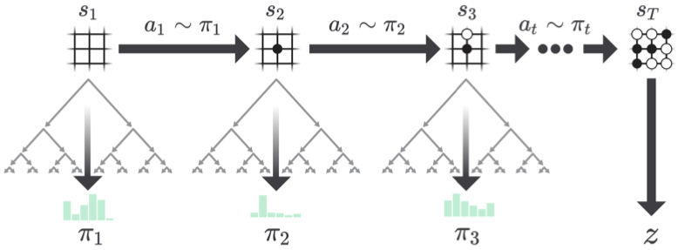
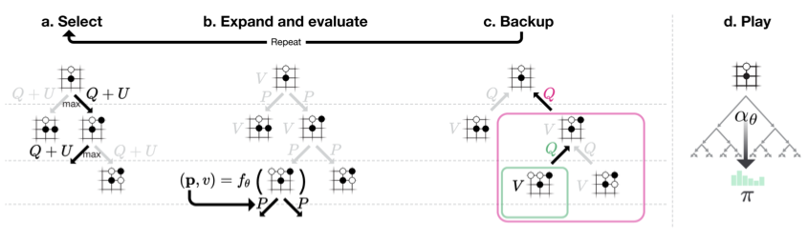
How does AlphaZero work?
Self-play
Notes:
The neural network is only a part of AlphaZero. Its second component is the Monte Carlo Tree Search Algorithm which is used to ‘tune’ the probability distribution returned by the network by exploring different scenarios resulting from different actions taken at the current state in many simulations (800 in this case) of self-play.
After these MCTS simulations, the root move that was visited most is played.
This algorithm trades off exploration and exploitation with its specific formula used for the action selection.
The self-play phase, in which AlphaZero plays against itself, generates the data for training, i.e. each move results in the probability distribution from the network, the probability distribution from MCTS, the value from the network, and, after finishing each game, the result of the game which equals 1 for a win, 0 for draw and -1 for a loss.
It’s important to keep in mind that, in the context of AlphaZero, ‘prior’ refers to the initial probability distribution of the network, i.e. before applying MCTS. Therefore, the action taken by AlphaZero doesn’t have to be the one with the highest probability in its prior.

Slide 9
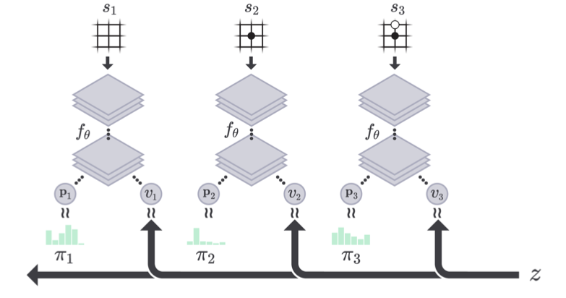
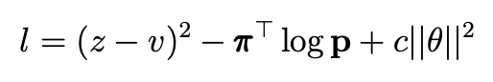
How does AlphaZero work?
b) Training
Notes:
The loss function:
uses a squared loss component for the final result of the game (z) and value v from the network
additionally minimizes the kullback-leibler divergence between the networks’ prior and MCTS probability distribution
applies L2 regularization with a constant c
The value v is used in the MCTS algorithm in the move selection procedure, so predicting it accurately is also important.

Slide 10
Why bother explaining it?
Notes:
Discovery of new chess variants

Slide 11
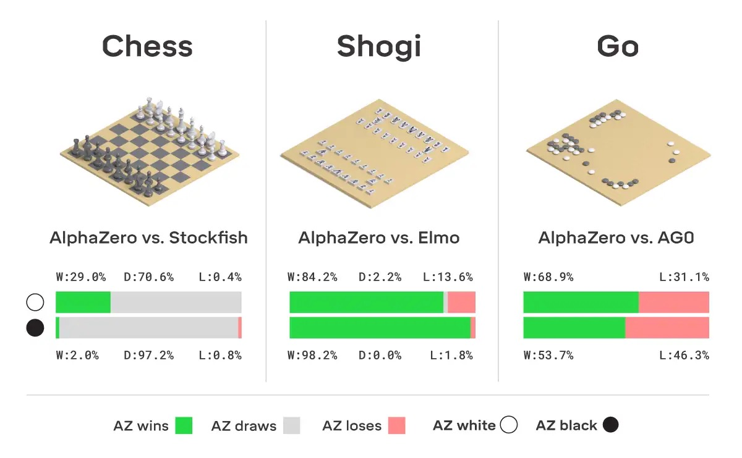
Why bother explaining it?

Slide 12
Encoding of human conceptual knowledge
Notes:
We shall begin with discovering the knowledge of man-made concepts (so in a supervised approach, as they are defined e.g. in Stockfish for position evaluation) inside AlphaZero.

Slide 13
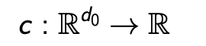
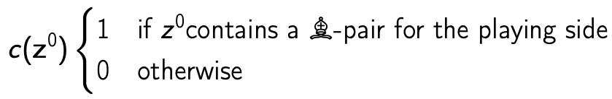
Encoding of human conceptual knowledge
Concept is a user-defined function on network input z⁰
Notes:
In the context of the next few slides, we will recognize the concept as a user-defined function on the network input z^0.

Slide 14
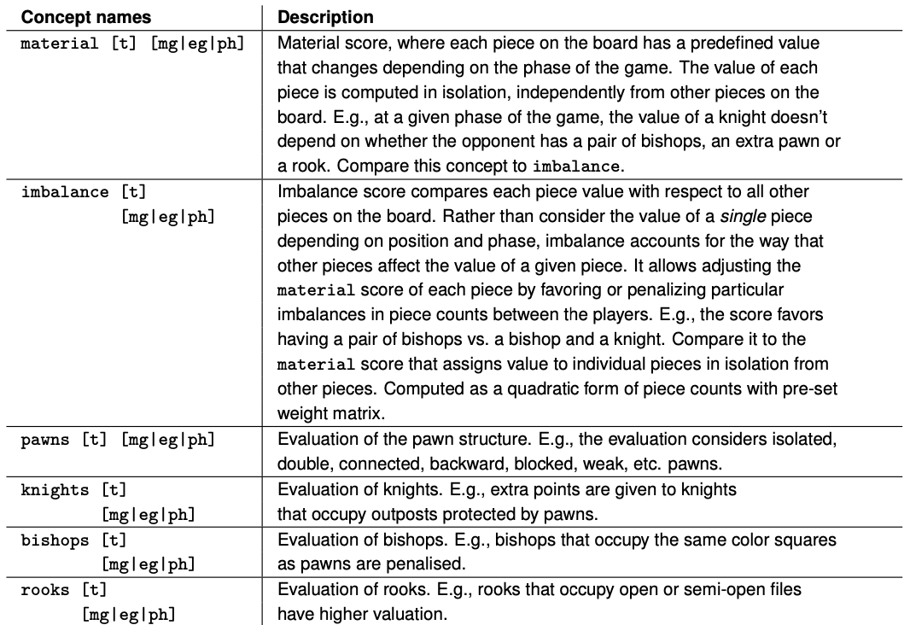
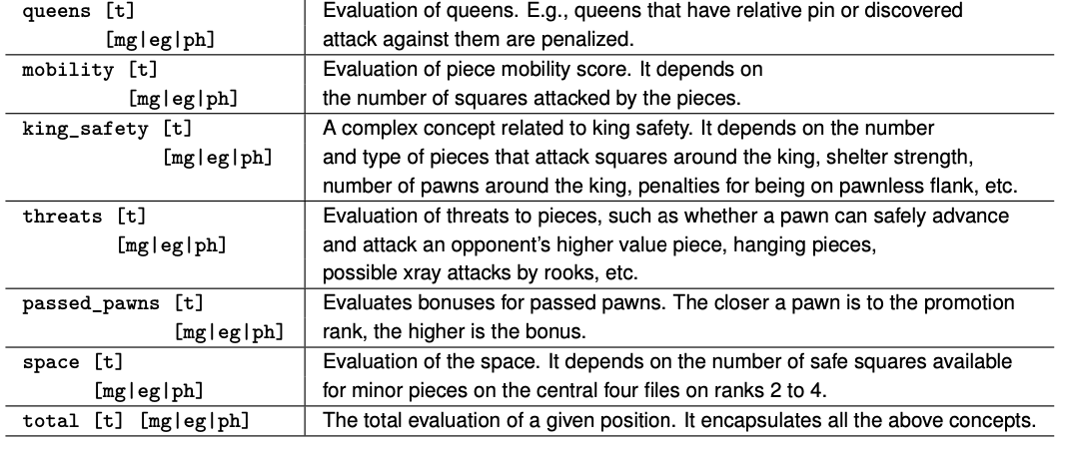
Encoding of human conceptual knowledge
Notes:
There are more than 100 human-engineered concepts, both binary and continuous, simple and complex.

Slide 15
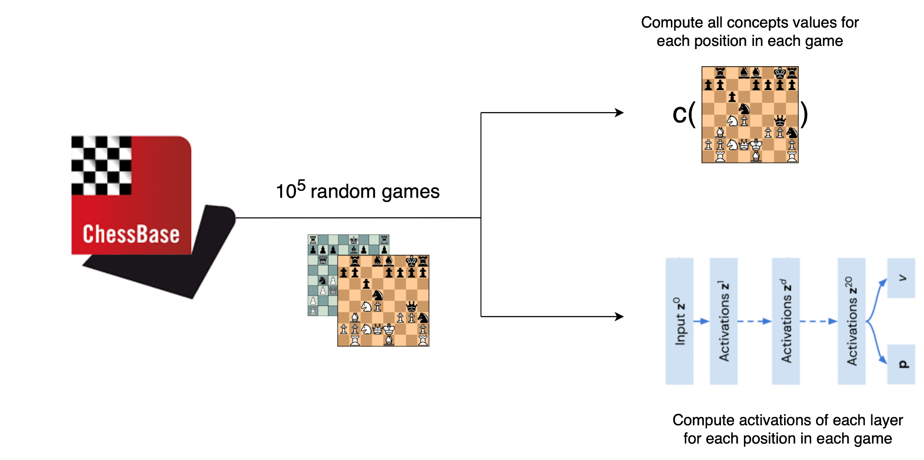
Encoding of human conceptual knowledge
Notes:
To discover the encoding of human concepts inside AlphaZero, the authors of the paper began with randomly drawing 10^5 games from the ChessBase database.
For each position in each of these games
all concepts values were calculated
activations of each layer were computed

Slide 16
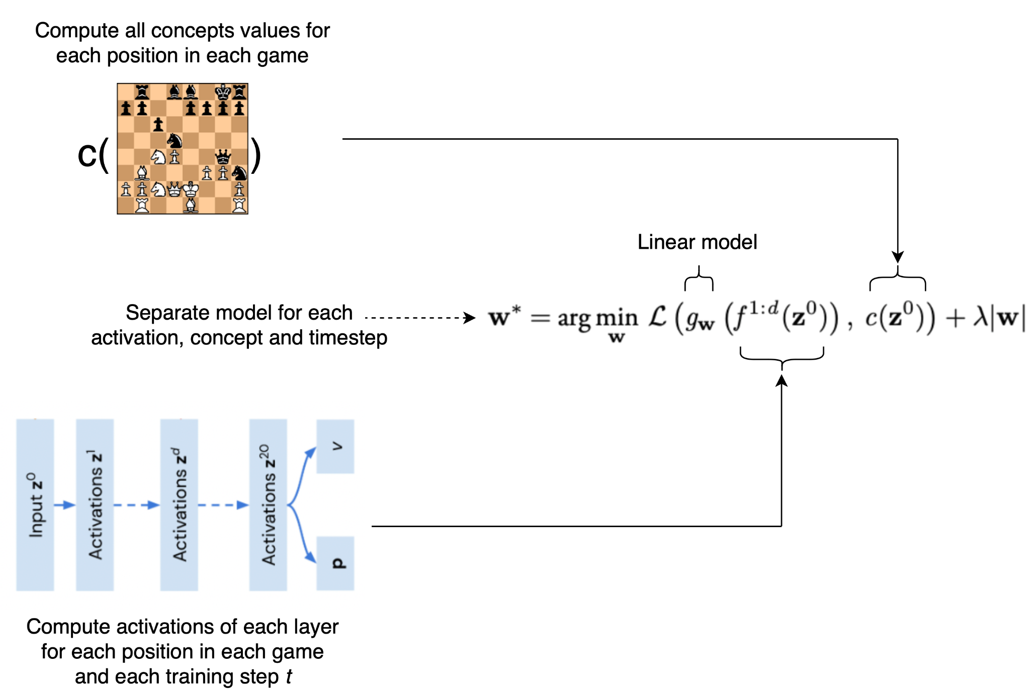
Encoding of human conceptual knowledge
Notes:
These were then used to train a huge number of linear models: logistic regression for binary concepts and linear regression for continuous concepts, both with L1 regularization.
The loss was calculated between the value of a concept at a given position and the activation of dth layer of the network at timestep t of its training.
The data was split into training, validation and test sets to first train the model and find the regularization coefficient, and then test its accuracy.
The scores of the models had to be normalized since the authors were using both the classificators and regressors.
Logistic regression was scored with normalized accuracy, i.e. 50% of standard accuracy gave a score of zero
Linear regression was scored with R^2 (coefficient of determination)

Slide 17
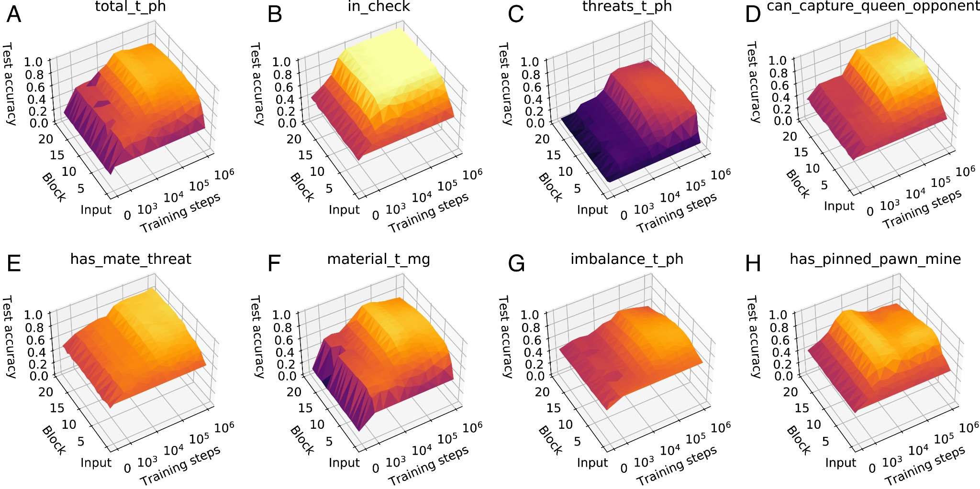
Encoding of human conceptual knowledge

Slide 18
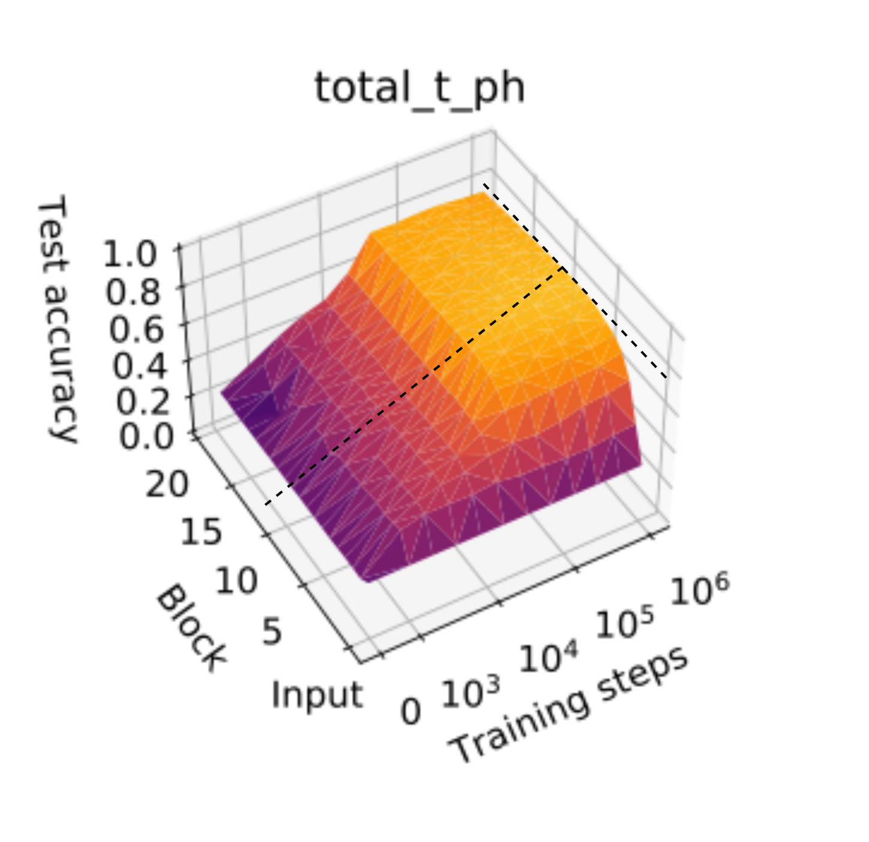
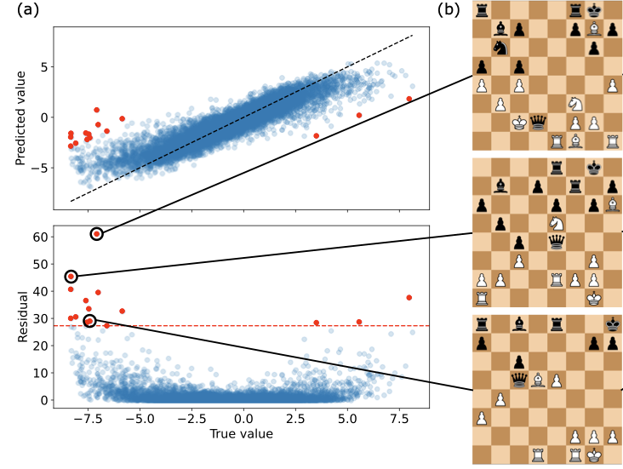
Encoding of human conceptual knowledge
Notes:
total_t_ph - Stockfish 8 ‘total score’
The outliers highlight potential differences between Alpha-Zero’s search and Stockfish’s concept calculation, In all 12 outlier positions where the regressed score is more favorable to white than the Stockfish score, black’s queen can be recaptured as part of an exchange sequence.
Recapture - capture a piece of the opponent after he first captures your piece
AlphaZero seems to have some planning encoded while Stockfish doesn’t because other things take care of it?
Summary: Stockfish’s value of this concept doesn’t include planning, while AlphaZero does - it’s more favorable to white because the opponent’s queen can be recaptured as part of an exchange sequence.

Slide 19
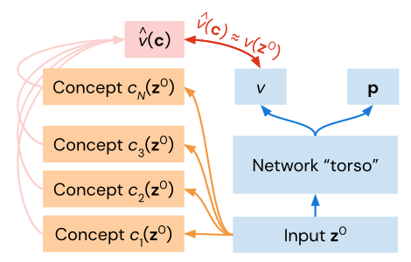
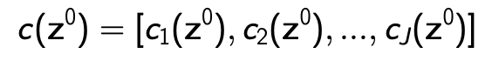
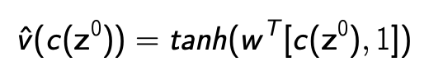
Encoding of human conceptual knowledge
We saw that intermediate representations in AlphaZero allow for predicting human-defined concepts.
This, however, doesn’t determine how these concepts relate to the outputs of the network.
Notes:
Many human-defined concepts can be predicted with high but not perfect accuracy from intermediate representations in AlphaZero when training has progressed sufficiently, but this does not determine how these concepts relate to the outputs of the network
Even though intermediate representations allow for predicting human-defined concepts, it doesn’t necessarily mean that they are actually used by the network and can be ‘seen’ in its output.
As their next approach, the authors proposed to try to predict the value v from the network (i.e. estimated expected return, can be understood as a value between -1 and 1 that the higher it is, the bigger the chance of winning).
Their approach was based on regressing this value by using the values of different concepts on the input to the network. This way, they could check whether these concepts have any predictive power.
how AlphaZero’s value function relates to human concepts over the course of training
v - position evaluation

Slide 20
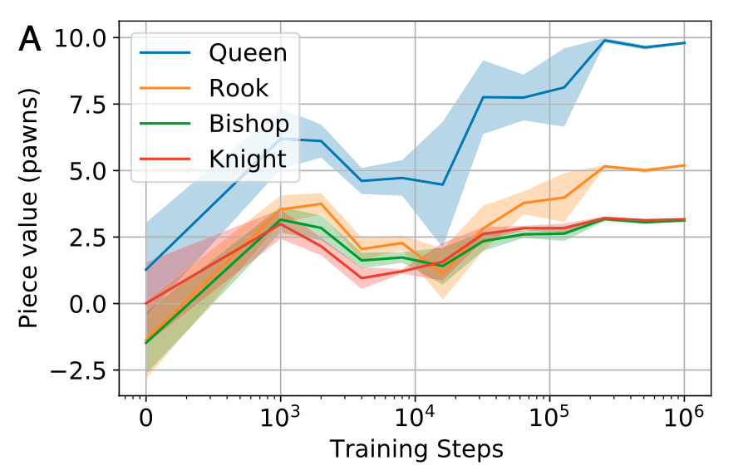
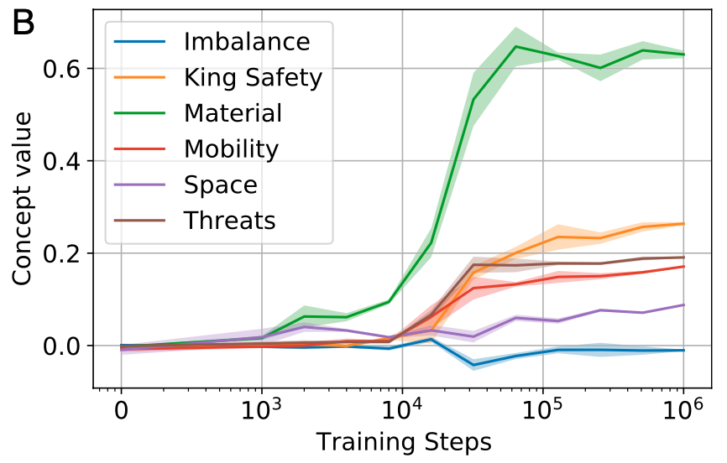
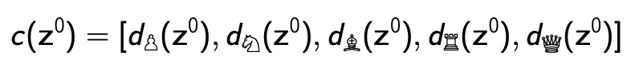
Encoding of human conceptual knowledge
Notes:
Left:
values of the pieces normalized by the corresponding pawn weight
the figure shows that piece values converge toward commonly accepted values after 128k training steps
simple values for material are one of the first things a beginner chess player learns, and they allow for basic assessment of a position.
Right:
more complex concepts
At initialization, no concept weights are statistically significantly different from zero at 95% confidence.
Material and space are the first concepts to differ significantly from zero at 2k training steps.
More sophisticated concepts, such as king safety, threats, and mobility, become statistically significantly nonzero only past 8k steps and only increase substantially at 32k steps and beyond. This coincides with the point when there is a sharp rise in r2 in their what–when–where plots
The imbalance concept appears to play a marginal role in position evaluation; although it receives nonzero weight at 32k training steps, the weight assigned to it is minimal and rapidly reverts to being approximately zero.
Interestingly, although imbalance-related information can be regressed from early layers of the network (Fig. 2G), it cannot be regressed from the final layer of the torso, which is consistent with it not playing a direct role in position evaluation.

Slide 21
Progression through AlphaZero and human history

Slide 22
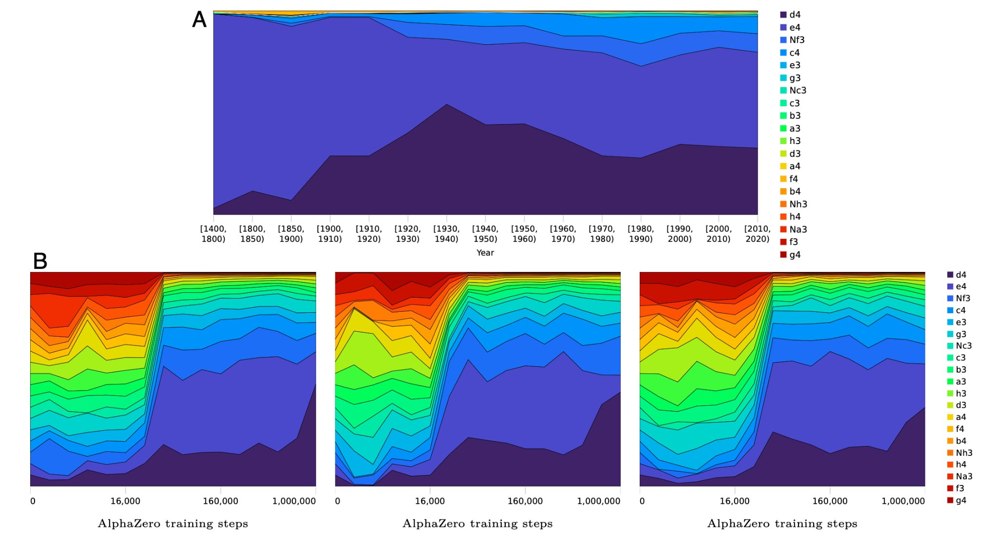
Progression through AlphaZero and human history
First move preference
Human history
AlphaZero history
Notes:
An analysis of AlphaZero’s prior shows that it starts with an effectively uniform distribution of opening moves, allowing it to explore all options equally, and then remove narrows down options over time
In quantitative terms, the entropy of AlphaZero’s first move prior reduces from 4.32 bits per move at the beginning of training to an average of 2.86 bits per move after 1 million training steps, averaged across different seeds.
By comparison, recorded human games over the last five centuries‡ point to an opposite pattern: an initial overwhelming preference for 1. e4, with an expansion of plausible options over time (Fig. 6A).
In modern tournament play, 1. d4 became slightly more popular in the early twentieth century, along with an increasing popularity of less forcing systems, like 1. c4 and 1. Nf3.
Human first move preferences in the early recorded games between the years 1400 and 1800 empirically encode a mere 0.33 bits of information, increasing to 1.87 bits of information in top- level play at the end of the twentieth century.
It may be that our historical data on human games emphasize collective knowledge of relatively expert players, while AlphaZero’s data include its “beginner-level” games and a single evolving strategy.

Slide 23
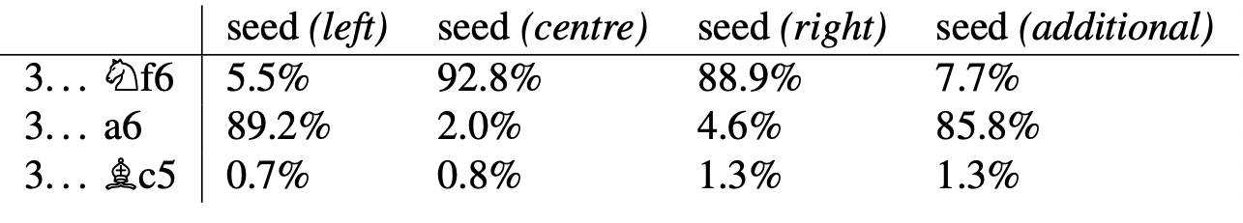
Progression through AlphaZero and human history
Response to Ruy Lopez (1. e4 e5 2. Nf3 Nc6 3. Bb5)
Notes:
When AlphaZero is trained more than once, do the resulting networks show a stable preference for certain lines?
Two responses, 3 ... Nf6 and 3 ... a6, are considered equally good by many today, with a rich history behind this assessment. The Berlin defense with 3 . . . Nf6 was first championed by GM Vladimir Kramnik. at top-level play.
For many years, it was considered a slightly worse response than 3 . . . a6, and human chess opening theory has relatively recently appreciated the benefits of the Berlin defense and established effective ways of playing with black in this position.
We can find different training runs in which AlphaZero con- verges to either of these two main moves (Table 1). Moreover, individual AlphaZero models encode a strong preference for one move over the other, despite their apparent near equivalence. (That different training runs converge on different lines adds weight to the human opinion that neither provides a definitive advantage.)

Slide 24
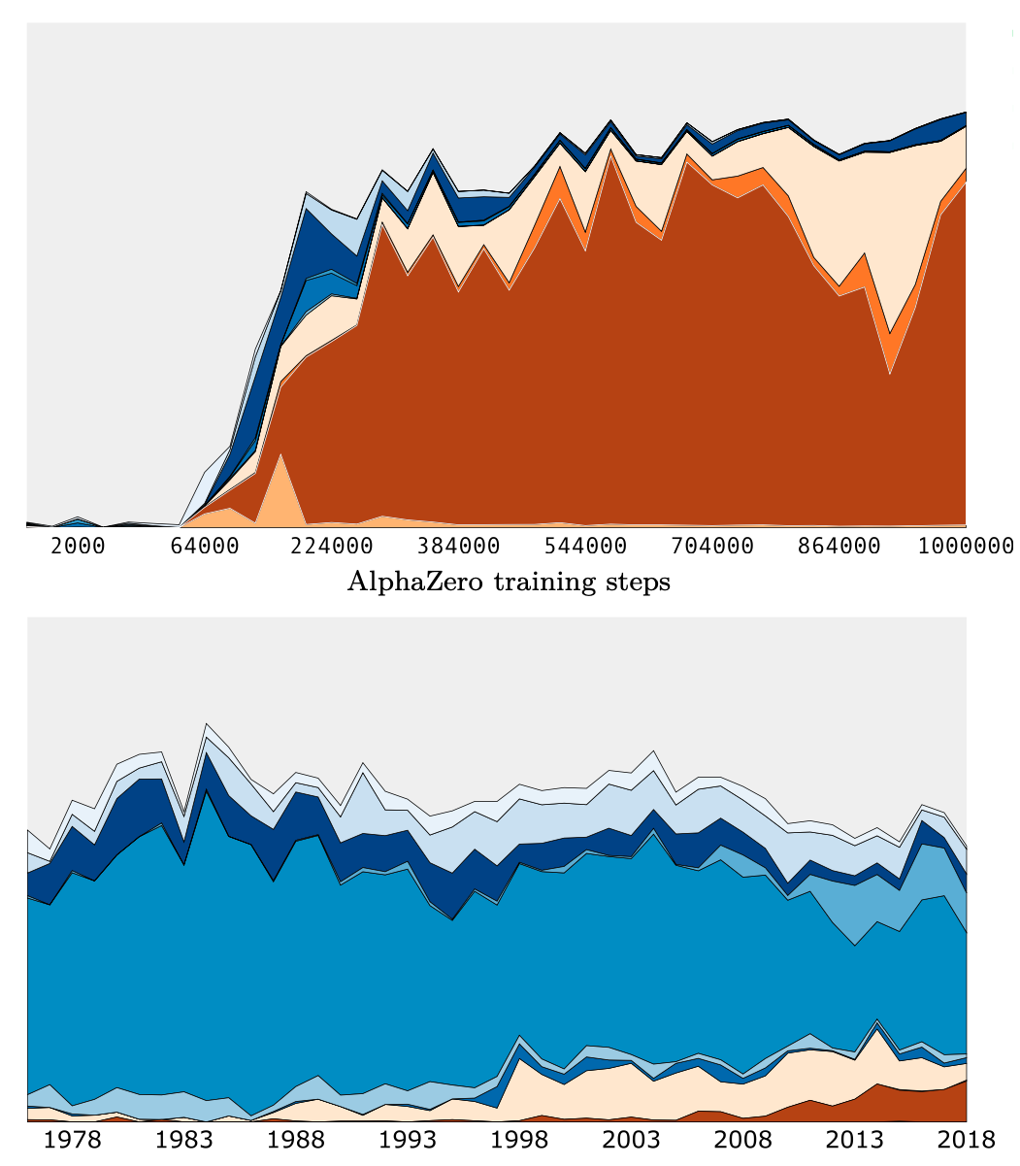
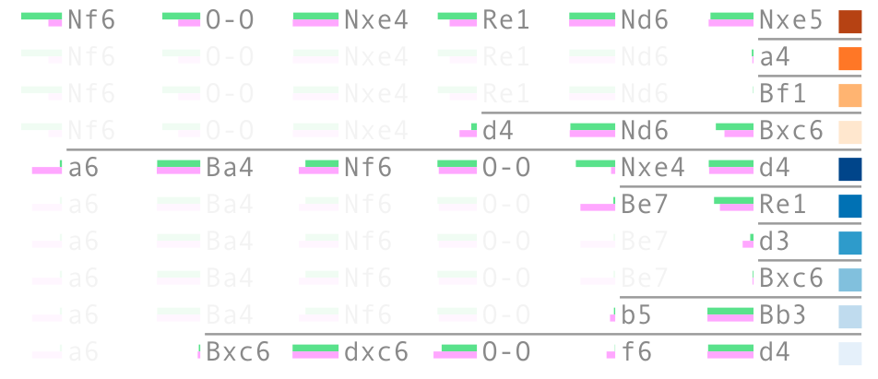
Progression through AlphaZero and human history
Notes:
Top 4 AlphaZero (top to center) continuations from Ruy Lopez and top 6 (bottom to center) from human grandmasters
It illustrates a case when AlphaZero’s preferences take a different path from human history, and where the Berlin defense system (3. . . Nf6) is preferred.
This system was championed by GM Vladimir Kramnik at top level
Looking back in time, it took a while for human chess opening theory to fully appreciate the benefits of Berlin defense and to establish effective ways of playing with Black in this position.
On the other hand, AlphaZero develops a preference for this line of play quite rapidly, upon mastering the basic concepts of the game. This already highlights a notable difference in opening play evolution between the humans and the machine.
The variability in these lines is

Slide 25
Rapid increase of basic knowledge
Notes:
During the course of AlphaZero’s million training steps, there is an inflection point where the network understands “enough” about piece value that playing basic opening sequences (like playing 1. e4 and not 1. f3) lead to tangible advantages.
From the previous evidence, Stockfish’s evaluation sub-function of material is strongly indicative of the AlphaZero network’s value assessment. Tthe concept of material and its importance in the evaluation of a position is largely learned between training steps 10k and 30k, and then refined.
Furthermore, the concept of piece mobility is progressively incorporated in AlphaZero’s value head in the same period. It is plausible that a basic understanding of the material value of pieces should precede a rudimentary understanding that greater piece mobility is advantageous.
Therefore, a clear transition appears which we’ll now examine in detail.

Slide 26
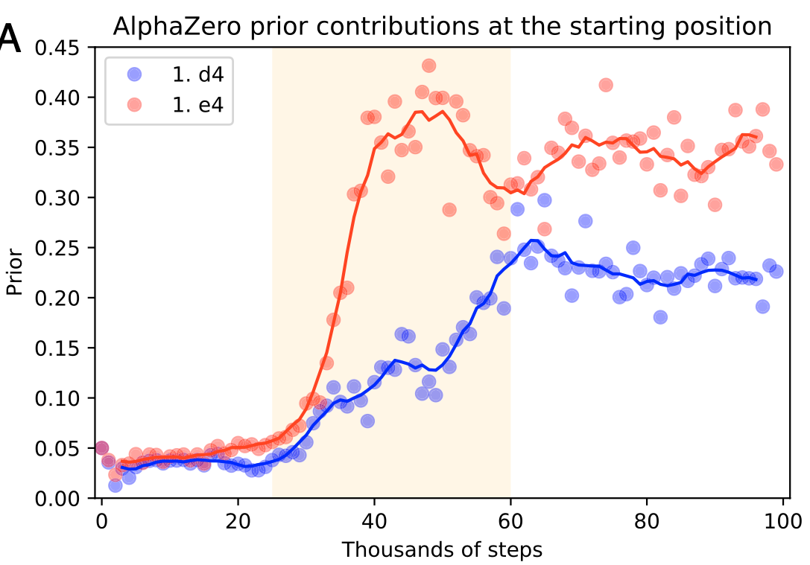
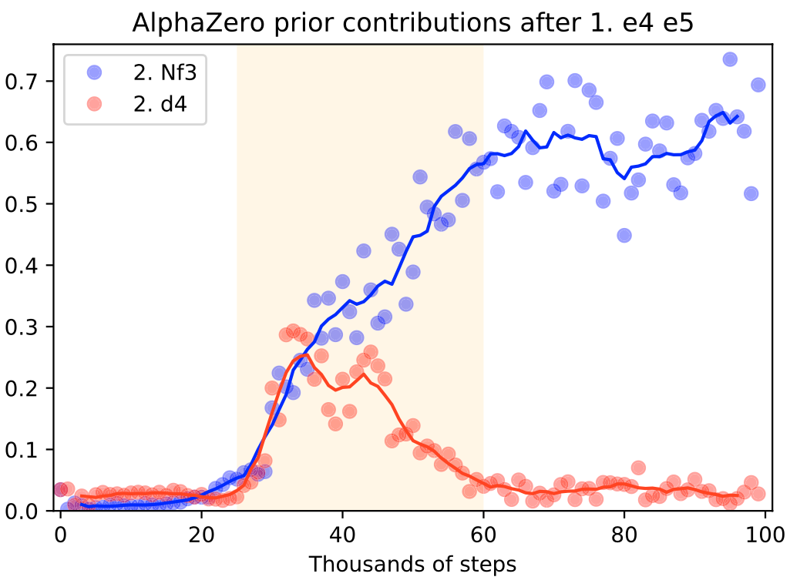
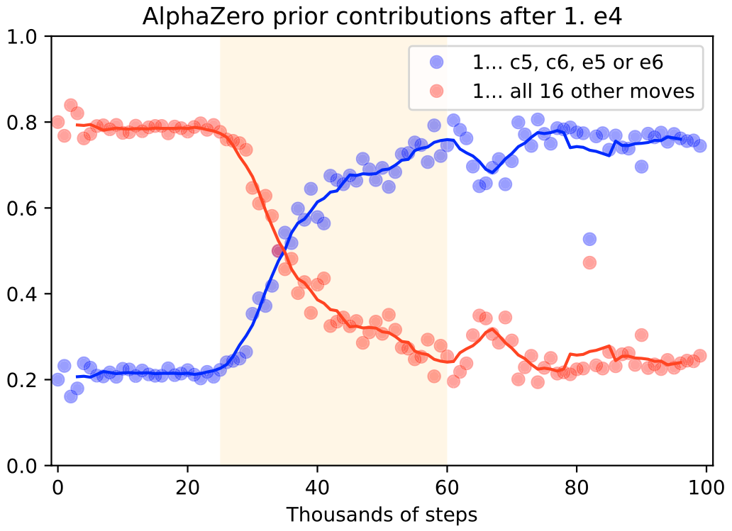
Rapid increase of basic knowledge
Notes:
To examine the transition, we consider the contribution of familiar opening moves as a fraction of the AlphaZero prior over all moves
Figure 7a:
1. d4 and 1. e4 are discovered to be good opening moves, and are rapidly adopted within a short period of around 30k training steps.
Figure 7b:
Similarly, AlphaZero’s preferred continuation after 1. e4 e5 is determined in the same short temporal window. Figure in the middle illustrates how both 2. d4 and 2. Nf3 are quickly learned as reasonable White moves, but 2. d4 is then dropped almost as quickly in favour of 2. Nf3 as a standard reply.
Figure 7c:
Looking beyond individual moves, the authors group AlphaZero’s responses to 1. e4 into two sets, 1. . . c5, c6, e5 or e6 and then all 16 other moves.
Figure on the right shows how 1. . . c5, c6, e5 or e6 together account for 20% of the prior mass when the network is initialized, as they should, as they are four out of twenty possible Black responses. However, after 25k training steps their contribution rapidly grows to account for 80% of the prior mass.

Slide 27
Vladimir Kramnik’s qualitative assessment

Slide 28
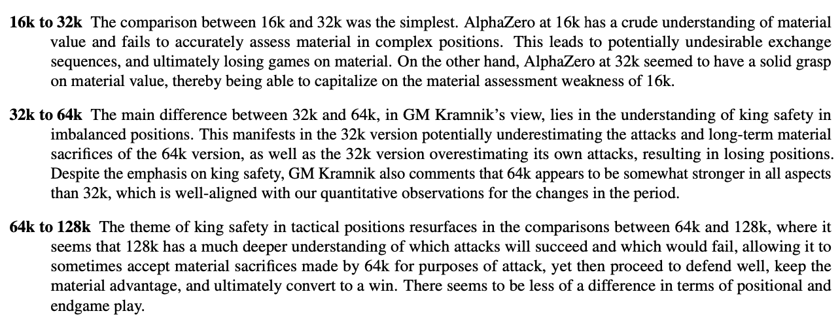
Vladimir Kramnik’s qualitative assessment
Notes:
From observing AlphaZero’s self-play games over increasing training steps, Vladimir Kramnik remarked that tactical skills appear to precede positional skills as AlphaZero learns.
To collect more supporting evidence, GM Kramnik selected two sets of 10 opening lines based on their known theoretical properties. The first set contained starting positions corresponding to quiet and positional opening systems like the Berlin defense, Queen’s gambit declined, Queen’s gambit accepted and the English opening. The second set contained starting positions corresponding to aggressive and tactical opening systems like the Najdorf Sicilian, Nimzowitsch defense, the French Winawer and the King’s Indian defense Both the tactical and the positional lines were selected such that they are considered equal, not conferring an advantage to either player. In the self-play games, each version of AlphaZero had a chance to play as White and Black from the same position.

Slide 29
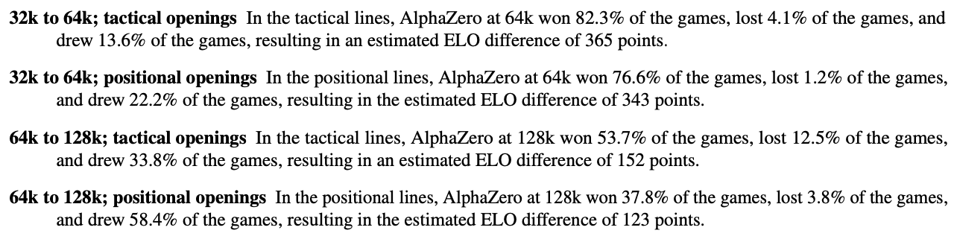
Vladimir Kramnik’s qualitative assessment
Notes:
Tactical players would be those who attack and sacrifice pieces for advantages, while positional players are those who put their pieces on key squares for space advantage to limit what the opponent can do.
These experiments show that there is a marginal difference between game outcomes from tactical positions and game outcomes from more positional openings.
The slight difference in favour of tactical positions persists both in the comparison between the 128k and 64k model, as well as the 64k and 32k model.
The observed difference in ELO between the checkpoints playing positional and tactical lines is circumstantial evidence that tactical skill acquisition might happen before or faster than positional skill acquisition.
However, this is only one potential explanation of the differences. GM Kramnik’s remark points to further work to understand the order in which skills are acquired.

Slide 30
Exploring activations with unsupervised methods

Slide 31
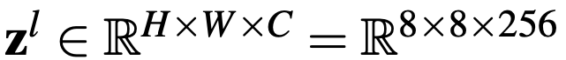
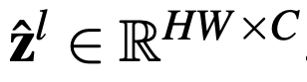
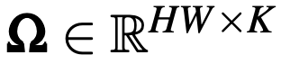
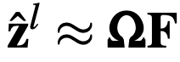
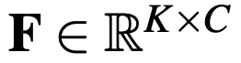
Exploring activations with unsupervised methods
Non-negative matrix factorisation
Weights (coefficients)
Factor matrix (basis)
For each layer (block), 36 factors are found
Notes:
Layer l’s activations zl ∈ RH×W×C = R8×8×256 are non-negative. Each of the 256 channels is an 8×8 plane. We treat each plane as a vector and reshape zl into a matrix zˆl ∈ RHW×C. This is a square-by-channel matrix, where every row corresponds to a square (a single field on the chessboard) and is a non-negative C-dimensional vector.
In app: block 2, 3, 4, factor 3

Slide 32
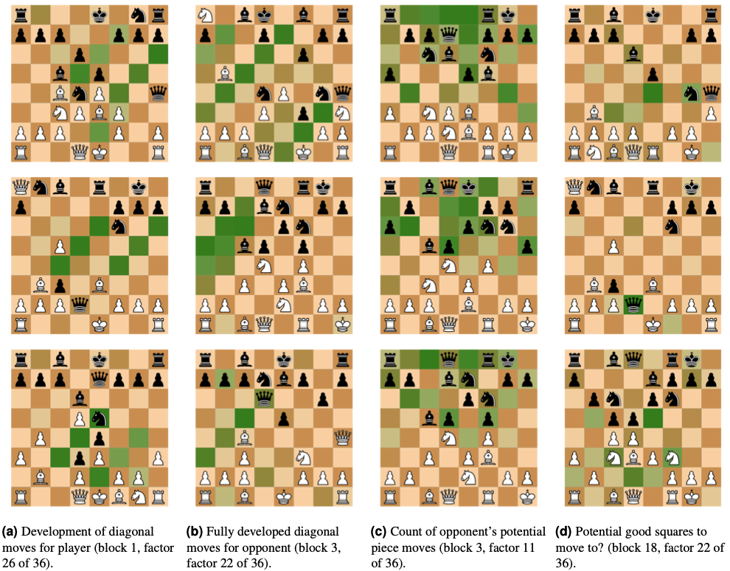
Exploring activations with unsupervised methods
Non-negative matrix factorisation
App
Notes:
Layer l’s activations zl ∈ RH×W×C = R8×8×256 are non-negative. Each of the 256 channels is an 8×8 plane. We treat each plane as a vector and reshape zl into a matrix zˆl ∈ RHW×C. This is a square-by-channel matrix, where every row corresponds to a square (a single field on the chessboard) and is a non-negative C-dimensional vector.
In app: block 2, 3, 4, factor 3

Slide 33
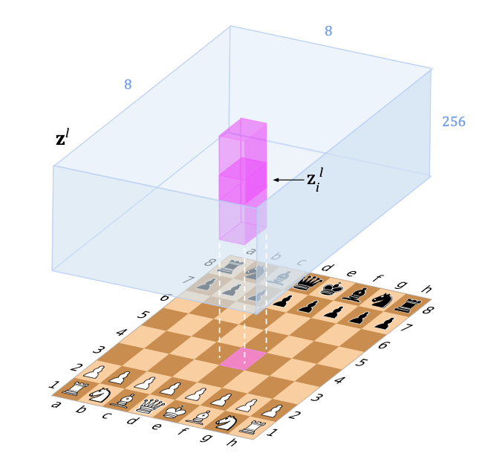
Exploring activations with unsupervised methods
Activation-input covariance
Notes:
Layer l’s activations zl ∈ RH×W×C = R8×8×256 are non-negative. Each of the 256 channels is an 8×8 plane. We treat each plane as a vector and reshape zl into a matrix zˆl ∈ RHW×C. This is a square-by-channel matrix, where every row corresponds to a square (a single field on the chessboard) and is a non-negative C-dimensional vector.
In app: block 2, 3, 4, factor 3

Slide 34
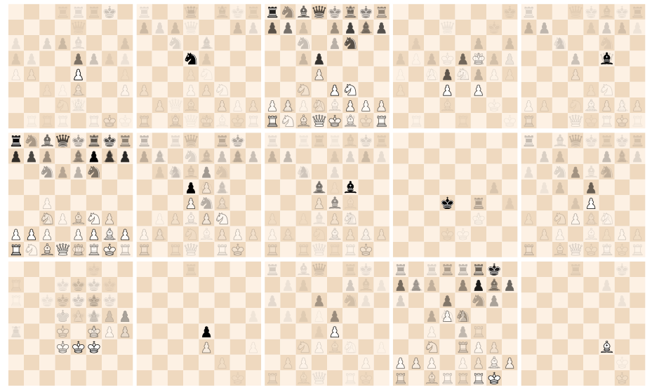
Exploring activations with unsupervised methods
Activation-input covariance
c = 1,...,5
c = 6,...,10
c = 11,...,15
The activation-input covariance for the first layer, with activations i = (5, 4, c), iterating over channels c = 1, ..., 15.
Notes:
There is evidence that lower layers are likely to encode less abstract and therefore more location specific concepts.
To illustrate the role of lower layers as feature detectors, the authors pick square e4 and visualize the activations from layer 1 that align with it spatially. In the figure above they showed the activation-input covariances of channels c = 1,...,15 of i = (5,4,c) in z1.
Layer 1 in Figure 1 follows after applying a bank of 3 × 3 convolution filters, and we expect only local 3 × 3 patterns around e4 to be correlated with the activations in all channels. The correlations are indeed localized; index (5, 4) corresponds to the e4 square on the board, and after a 3 × 3 convolution (see Figure 1) piece patterns around the e4 square are detected.
There are also a number of global positions that appear in the covariance visualizations in Figure 10. It is because of correlations in the data.

Slide 35
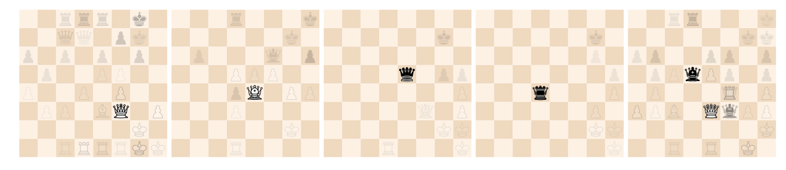
Exploring activations with unsupervised methods
Activation-input covariance

Slide 36
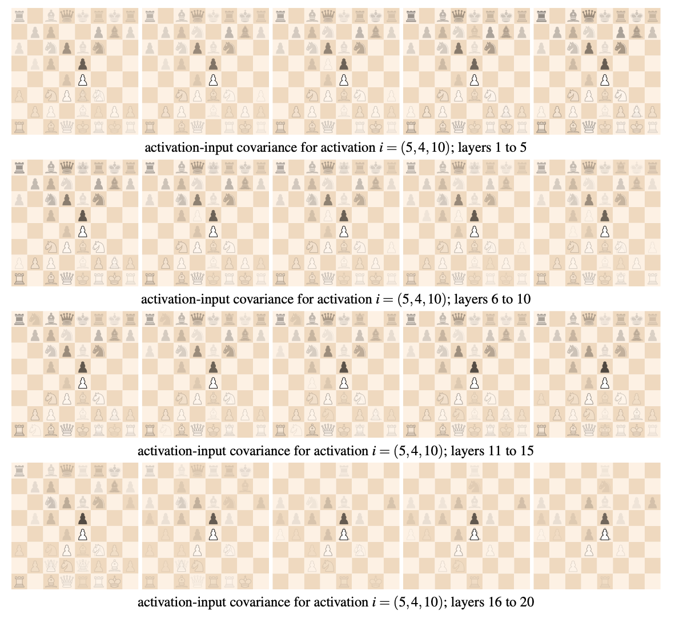
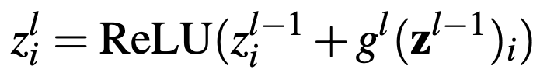
Exploring activations with unsupervised methods
Activation-input covariance
combines:
propagating information forward through z_{i}^{l-1}
evolving by incorporating additional local context through g ^{l} (z ^{l-1} )_{i}
Notes:
The activation-input covariance cov(zli,z0) for layers 1 to 20 for activations i = (5,4,10) in each layer l. Unlike Figure 13, the unit is persistently activated when there are opposing central pawn; the detection of two opposing central pawns are propagated through all layers of the network.

Slide 37

Exploring activations with unsupervised methods
Activation-input covariance
Local patterns from the beginning of the network can become increasingly global as activations are propagated further and may evolve into different patterns.
Notes:
Moving up the network, with White to play, features revolve around a central light-squared bishop. These evolve to a central opposing pawn on e4, to finally a Nc3 (attacking e4).

Slide 38
Thank you for your attention!

